Slide 1

STEC Medina County Large Load Project (25RPG046)
Project Overview for ERCOT RPG
February 2, 2026

Slide 2
Project Overview
The proposed project aims to support interconnection of an additional 980 MWs of load in Medina County.
The interconnection study for the proposed 980 MWs of load has identified transmission system reliability criteria violations per Section 4 of the ERCOT Planning Guide (EPG).
STEC evaluated two (2) transmission system improvement options to address reliability issues observed in the load interconnection study.
Based on the analysis performed, STEC identified Alternative 2 (description on next slide) as the preferred option.
Alternative 2 is a Tier 1 project estimated to cost $492 million, with an estimate in-service date of January 2031. The project will require a Certificate of Convenience and Necessity (CCN)

Slide 3
Project Overview
Alternative 2, the preferred option, includes the following transmission system improvements.
Construct a new STEC-owned Alsatian 345/138 kV station on the Bader to Pearson 138 kV line (~0.8 miles from the Bader station) with two 345/138 kV autotransformers rated at least 675/675 MVA (Normal/Emergency).
Construct a new CPS Energy-owned three-terminal 345 kV switching station in the Kendall to Cagnon 345 kV line (~5 miles north of Cagnon station).
Construct a new 345 kV single-circuit transmission line rated at least 1746/1746 MVA (Normal/Emergency) on double-circuit-capable structures from the new CPS 345 kV switching station in the Cagnon to Kendall 345 kV transmission line to the new STEC-owned Alsatian 345/138 kV station. A Certificate of Convenience and Necessity (CCN) will be required.
Construct a new 345 kV single-circuit transmission line rated at least 1746/1746 MVA (Normal/Emergency) on double-circuit-capable structures from CPS Howard station to the new STEC-owned Alsatian 345/138 kV station. A Certificate of Convenience and Necessity (CCN) will be required.
Construct a second 138 kV circuit along the existing Pearson to Castroville corridor, consisting of the following line segments: Pearson to Dunlay, Dunlay to the new STEC Alsatian station, the new STEC Alsatian station to Bader, and Bader to Castroville, rated 426/474 MVA (Normal/Emergency).
Rebuild STEC’s Palo Duro to Dilley 138 kV line with a conductor rated at least 312/312 MVA (Normal/Emergency).
Rebuild CPS Energy’s Bandera to Hamilton Wolf 138 kV line with conductors rated at least 371/371 MVA (Normal/Emergency).
Rebuild CPS Energy’s Cachena to Elmcreek 345 kV line with conductors rated at least 1250/1250 MVA (Normal/Emergency).
Rebuild CPS Energy’s Howard to Spruce 345 kV line with conductors rated at least 1580/1580 MVA (Normal/Emergency).
Rebuild CPS Energy’s Howard to Braunig 345 kV with conductors rated at least 1457/1457 MVA (Normal/Emergency).
Rebuild CPS Energy’s/AEP’s Lytle to Lytle 138 kV line with conductors rated at least 354/354 MVA (Normal/Emergency).
Upgrade CPS Energy’s Hill Country 345/138 kV autotransformers #3 and #4 to at least 740/740 MVA (Normal/Emergency).
Install a new capacitor bank with at least 19.2 MVAr at STEC’s Natalia 69 kV station.
Install a new capacitor bank with at least 134 MVAr at AEP’s Lytle 138 kV station.
Install a new capacitor bank with at least 5.6 MVAr at AEP’s Asherton 138 kV station.
Install a new 162 MVAr capacitor bank on the 138 kV side of the new STEC-owned Alsatian 345/138 kV station.

Slide 4
Project Overview
Alternative 2 (cont.), the preferred option, includes the following transmission system improvements.
Install a third 345/138kV autotransformer rated at least 675/675 MVA (Normal/Emergency) at the new Alsatian 345/138 kV station.
Add the second 138 kV circuit along the existing Legend Falls to STEC Castroville corridor, consisting of the following line segments: Legend Falls to San Geronimo, San Geronimo to Rio Medina, and Rio Medina to Castroville, rated 426/474 MVA (Normal/Emergency).
Rebuild STEC’s Hondo Creek to Devine 69 kV line with conductors rated at least 109/109 MVA (Normal/Emergency).
Rebuild AEP’s Big Foot to Pleasanton 138 kV line with conductors rated at least 147/147 MVA (Normal/Emergency).
Rebuild CPS Energy’s Lytle to Somerset 138 kV line with conductors rated at least 339/339 MVA (Normal/Emergency).
Rebuild CPS Energy’s Omicron to Rafter 138 kV line with conductors rated at least 642/642 MVA (Normal/Emergency).
Rebuild CPS Energy’s Cagnon to Texas Research 138 kV with conductors rated at least 465/465 MVA (Normal/Emergency).
Install a new capacitor bank with at least 9.2 MVAr at CPS Energy’s Somerset 138kV station.
Install a new capacitor bank with at least 55.01 MVAr at Pearsall Switching Station 69 kV bus.
Install an additional 223 MVAr of reactive support at the new Alsatian 345/138 kV Station.

Slide 5
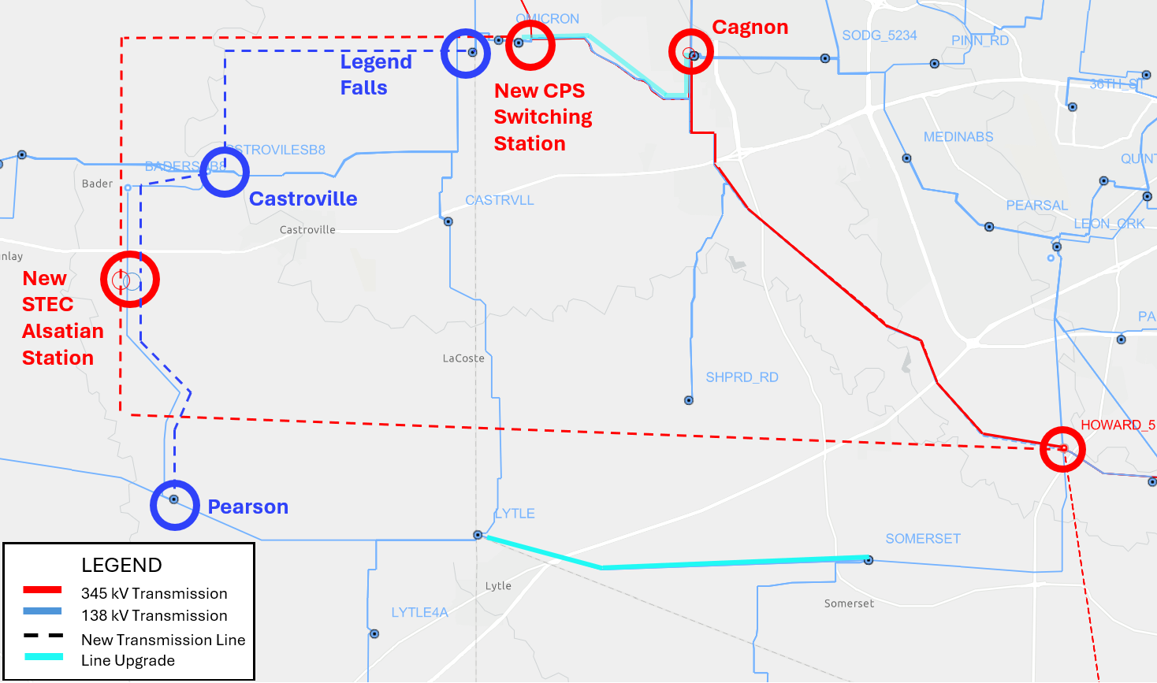
Project Overview

Slide 6
Project Need
Address the violations under NERC TPL-001-5 and EPG criteria contingencies and ensure reliable integration of the proposed 980 MW Load
Violations observed in the initial steady state assessment include
P1, P3, P2/P4/P5, P6, EPG Section 4.1.1.2 (d), and EPG section 4.1.1.2 (e) contingency event violations observed in summer peak (SP) conditions
P1, P3, P2/P4/P5, P6, EPG section 4.1.1.2(d), EPG section 4.1.1.2 (e), and EPG section 4.1.1.8 contingency event violations observed in Minimum Load (HRML) (off-peak) conditions
Based on the results of STEC’s assessment, the facility loading violations and/or low voltage issues on the following transmission system facilities are observed following addition of proposed load:
345kV Howard - Spruce line
345kV Howard - Braunig line
138kV AEP Lytle – CPS Lytle line
138kV CPS Lytle – Somerset line
138kV Rafter – TX Research line
138kV Cagnon – TX Research line
138kV Cagnon – Omicron line
138kV Howard – Omicron line
138kV Legend Falls – TX Research Line
138kV San Geronimo – Legend Falls line
138kV San Geronimo – Rio Medina line
138kV Pearson – CPS Lytle line
138kV Pearson – Hondo line
138kV Pearson – Dunlay line
138kV Hondo Creek – Hondo line
69kV Hondo Creek – Devine line
138kV Castroville – Rio Medina line
138kV Dunlay – Rodgers and Edwards new POI line
138kV Bader – Rodgers and Edwards new POI line
138kV Bader – Castroville line
138kV Castroville – CPS Castroville line
138kV CPS Castroville – CPS Lytle
69kV Ferris - Downie line
138kV AEP Pleasanton – AEP Big Foot
Cagnon 345/138kV autotransformer
Hill Country 345/138kV autotransformers #3 and #4
138kV Moore - Pearsall line
69kV Poteet - Pleasanton line
Additional VAR support for low voltage issues

Slide 7
Study Methodology Overview
ERCOT 2024 Steady State Working Group (SSWG) U1 2028SP, 2031SP, and 2028HRML cases are used for assessment
Incremental topology changes are incorporated to derive the study cases for the assessment:
All off-cycle IDEVs that have been posted to the ERCOT MIS after the release date of the starting cases were applied.
Applied the June 2025 Transmission Planning and Information Tracking (TPIT) for transmission upgrades in the study area.
Added CPS Energy South San Antonio Reliability Projects 1 (22RPG048) and 2 (23RPG032) to the 2028SP because they were not previously modeled.
Applied any resources in the study area that met Section 6.9(1) requirements of the ERCOT Planning Guide not already modeled in the cases.
Firmly committed large loads in the vicinity were modeled to develop the base cases prior to adding the proposed load. A total of 259.5 MW of large load additions were included.
Reliability assessment was performed for the cases outlined above under the following conditions:​
P0 (normal operating conditions)
N-1 (P1, P2.1, and P7/ERCOT1) contingency conditions
Bus Fault, Internal Breaker Fault, Breaker Failure, and Relay Failure conditions (P2.2, P2.3, P4, and P5) on 345kV system
P3 and ERCOT 2 (G-1 + P7/ERCOT1) contingency conditions
ERCOT 3 (X-1 + P1/P7/ERCOT1) conditions around the loss of relevant 345/138kV auto transformers in the study area.
P6
P1+P7 and P7+P7 contingency conditions for off-peak condition.

Slide 8
Study Results Summary
Summary of EPG/NERC reliability criteria violations, 980 MW Medina County Large Load (Medina County, Texas)
Contingency Category | Case | Thermal Overloads (Exhibiting loading >100% of the 2-hr Emergency rating)* | Voltage Violations²
P0 | MIN/SP | 3 | None
P1s | MIN/SP | 19-33 | 26-30
P2, P4, P5 | MIN/SP | 21-31 | 34-53
P6 | MIN/SP | 41-60 | 60-58
ERCOT 3 (EPG section 4.1.1.2 (e)) | MIN/SP | 18-38 | 24-42
ERCOT2 (EPG section 4.1.1.2 (d)) & P3 | MIN/SP | 18-25 | 25-33
P1+P7 & P7+P7 (EPG section 4.1.1.8) | MIN/SP | 26-89 | 51-85
²Base case without upgrades but including the placeholder 591.58 MVAr capacitor at the new Large Load POI for convergence.

Slide 9
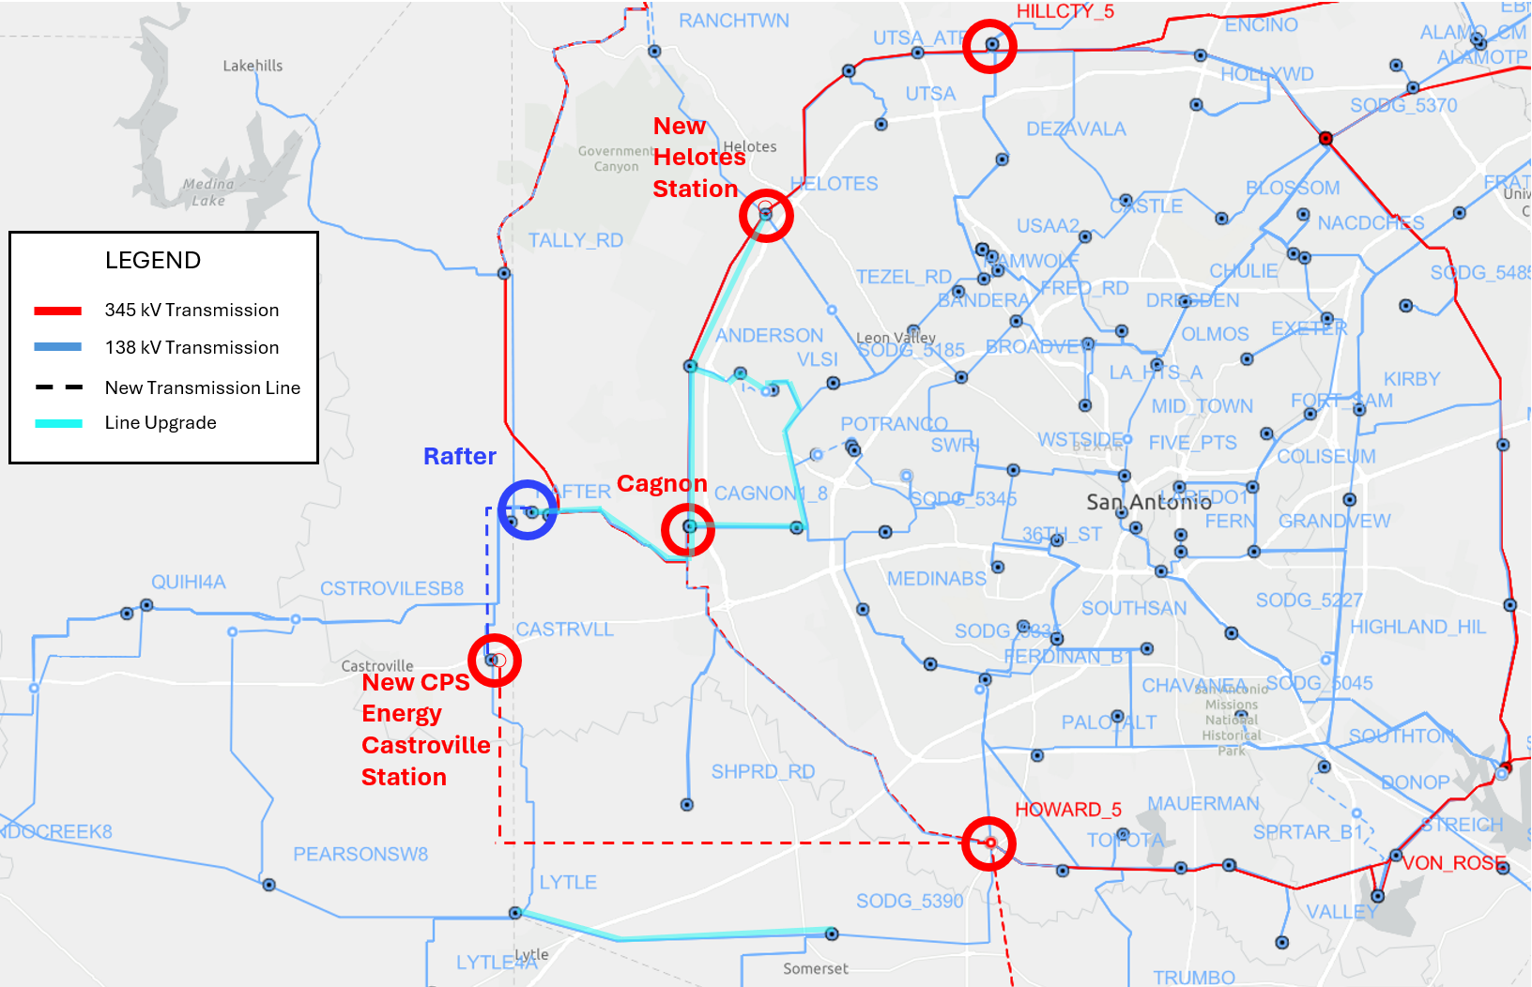
Alternative 1 – Without the 345 kV Loop to the new Alsatian station.
Build a new CPS Energy Castroville 345/138 kV Switching Station with three 600/600 MVA Normal/Emergency rating autotransformers.
Rebuild the CPS Energy Castroville to Rafter 138 kV transmission line circuit 1 to a minimum 698/698 MVA Normal/Emergency rating.
Build a new 138 kV Transmission Line from CPS Energy Castroville to Rafter circuit 2 with a minimum of 698/698 Normal/Emergency rating.
Build a new 345 kV transmission line from Howard to the new CPS Energy Castroville 345 kV station.
Rebuild the existing 138 kV transmission line from Grissom to VLSI to a minimum of 698/698 MVA Normal/Emergency rating.
Rebuild the existing 138 kV transmission line from Cagnon to VLSI to a minimum of 698/698 MVA Normal/Emergency rating.
Rebuild the existing 138 kV transmission line from Verde Circle to VLSI with a minimum 698/698 MVA Normal/Emergency rating.
Rebuild the 138 kV transmission line from Anderson to Rogers Rd to Westover Hills to a minimum 698/698 MVA Normal/Emergency rating.
Rebuild the existing 138 kV transmission line from Verde Circle to Westover Hills in existing easement to a minimum 698/698 MVA Normal/Emergency rating.

Slide 10
Alternative 1 (cont.)– Without the 345 kV Loop to the new Alsatian station.
Rebuild the existing 138 kV Anderson to Cagnon transmission corridor, which includes new 138 kV transmission lines from Cagnon to Kingsbridge and Kingsbridge to Wiseman, to a minimum of 698/698 MVA Normal/Emergency rating.
Rebuild the existing 138 kV Anderson to Helotes transmission corridor, which includes a new 138 kV transmission line from Helotes to Wiseman, to a minimum of 698/698 MVA Normal/Emergency rating.
Install a new 50 MVAr Capacitor Bank at Kingsbridge.
Install a new 50 MVAr Capacitor Bank at Whitetail.
Upgrade the Lytle to Somerset 138 kV line to 285/291 MVA Normal/Emergency rating.
Upgrade the Cagnon to Omicron 138 kV line to 478/565 MVA Normal/Emergency rating.
Upgrade the Bandera to St Hamilton Wolf 138 kV line to 289/318 MVA Normal/Emergency rating.
Upgrade the Cagnon 345/138 kV autotransformers (1,2,3) to 600/660 MVA Normal/Emergency rating.
Upgrade the Eastside 345/138 kV autotransformers (1,2,3) to 600/660 MVA Normal/Emergency rating.
Upgrade the Elm Creek to Shaula 345 kV line to 1025/1076 MVA Normal/Emergency rating
Upgrade the Tri County to Parkway 138 kV line to 326/342 MVA Normal/Emergency rating.
Upgrade the Kirby to St Hedwig 138 kV line to 250/255 MVA Normal/Emergency rating.

Slide 11
Alternative 2 – With the new 345 kV Loop to the new Alsatian
Construct a new STEC-owned Alsatian 345/138 kV station on the Bader to Pearson 138 kV line (~0.8 miles from the Bader station) with three 345/138 kV autotransformers rated at least 675/675 MVA (Normal/Emergency).
Construct a new CPS Energy-owned three-terminal 345 kV switching station on the Kendall to Cagnon 345 kV line (~5 miles from Cagnon station).
Construct a new 345 kV single-circuit transmission line rated at least 1746/1746 MVA (Normal/Emergency) on double-circuit-capable structures from a new CPS 345 kV switching station on the Cagnon to Kendall 345 kV transmission line to the new STEC-owned Alsatian 345/138 kV station. A Certificate of Convenience and Necessity (CCN) will be required.
Construct a new 345 kV single-circuit transmission line rated at least 1746/1746 MVA (Normal/Emergency) on double-circuit-capable structures from CPS Howard station to the new STEC-owned Alsatian 345/138 kV station. A Certificate of Convenience and Necessity (CCN) will be required.
Construct a second 138 kV circuit along the existing Pearson to Castroville corridor, consisting of the following line segments: Pearson to Dunlay, Dunlay to the new STEC Alsatian station, the new STEC Alsatian station to Bader, and Bader to Castroville, rated 426/474 MVA (Normal/Emergency).

Slide 12
Alternative 2 (cont.) – With the new 345 kV Loop to the new Alsatian
Add the second 138 kV circuit along the existing Legend Falls to STEC Castroville corridor, consisting of the following line segments: Legend Falls to San Geronimo, San Geronimo to Rio Medina, and Rio Medina to Castroville, rated 426/474 MVA (Normal/Emergency).
Rebuild STEC’s Palo Duro to Dilley 138 kV line with a conductor rated at least 312/312 MVA (Normal/Emergency).
Rebuild CPS Energy’s Bandera to Hamilton Wolf 138 kV line with conductors rated at least 371/371 MVA (Normal/Emergency).
Rebuild CPS Energy’s Cachena to Elmcreek 345 kV line with conductors rated at least 1250/1250 MVA (Normal/Emergency).
Rebuild CPS Energy’s Howard to Spruce 345 kV line with conductors rated at least 1580/1580 MVA (Normal/Emergency).
Rebuild CPS Energy’s Howard to Braunig 345 kV with conductors rated at least 1457/1457 MVA (Normal/Emergency).
Rebuild CPS Energy’s/AEP’s Lytle to Lytle 138 kV line with conductors rated at least 354/354 MVA (Normal/Emergency).
Upgrade CPS Energy’s Hill Country 345/138 kV autotransformers #3 and #4 to at least 740/740 MVA (Normal/Emergency).
Install a new capacitor bank with at least 19.2 MVAr at STEC’s Natalia 69 kV station.

Slide 13
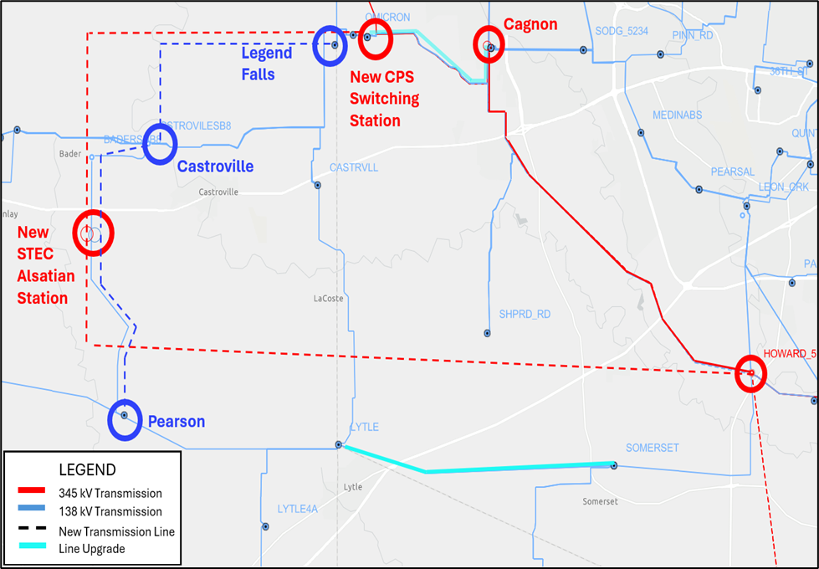
Alternative 2 (cont.) – With the new 345 kV Loop to the new Alsatian
Install a new capacitor bank with at least 134 MVAr at AEP’s Lytle 138 kV station.
Install a new capacitor bank with at least 5.6 MVAr at AEP’s Asherton 138 kV station.
Install a new 385 MVAr capacitor bank on the 138 kV side of the new STEC-owned Alsatian 345/138 kV station.
Rebuild STEC’s Hondo Creek to Devine 69 kV line with conductors rated at least 109/109 MVA (Normal/Emergency).
Rebuild AEP’s Big Foot to Pleasanton 138 kV line with conductors rated at least 147/147 MVA (Normal/Emergency).
Rebuild CPS Energy’s Lytle to Somerset 138 kV line with conductors rated at least 339/339 MVA (Normal/Emergency).
Rebuild CPS Energy’s Omicron to Rafter 138 kV line with conductors rated at least 642/642 MVA (Normal/Emergency).
Rebuild CPS Energy’s Cagnon to Texas Research 138 kV with conductors rated at least 465/465 MVA (Normal/Emergency).
Install a new capacitor bank with at least 9.2 MVAr at CPS Energy’s Somerset 138kV station.
Install a new capacitor bank with at least 55.01 MVAr at Pearsall Switching Station 69 kV bus.

Slide 14
Option Performance Evaluation
STEC performed steady state assessments for Alternatives 1 through 2 to mitigate the violations observed.
A summary of performances of Options 1 through 2 is provided below
Option | Addresses all thermal overloads per EPG requirements after load | Incremental Reliability Issues Observed | Voltage Security issues | Requires CCN (~ miles) | Preferred
1 | No | Yes | Yes | Yes | No
2 | Yes | No | No | Yes (~46) | Yes

Slide 15
Option Performance Summary
Alternative 1 do not resolve all EPG reliability violations observed after adding the proposed 980 MW load
Additionally, STEC observed new thermal overloads during summer peak and off-peak conditions for these options.
Alternative 2 adequately addresses all EPG violations for the conditions studied.
Mitigates all the thermal overloads and low voltage concerns observed under NERC and EPG criteria events for the conditions studied
No incremental issues observed
Cost-effective and reliable solution
Reliably integrates the proposed 980 MW load

Slide 16
Stability Assessment – Alternative 2
STEC utilized the ERCOT DWG 2025 flat start 2027 SP and 2028 HRML cases as the starting point of the stability analysis conducted for the study
STEC adopted assumptions consistent with the steady-state analysis to develop the stability study cases.
The impact of the proposed load and incremental implementation of Alternative 2 on system stability was evaluated, including:
Transient rotor angle stability
Voltage stability
The analysis focused on nearby transmission system performance under NERC and ERCOT planning guide events.
No transmission system stability concerns identified under any events studied, with proposed 980 MW load and Alternative 2 transmission improvements included

Slide 17
Short Circuit & SSR Assessment – Alternative 2
Short Circuit Assessment
STEC utilized the ERCOT System Protection Working Group (SPWG) 2030 FY case as the starting point of the short circuit analysis
STEC adopted assumptions consistent with the steady-state analysis to develop the short circuit study cases.
Fault duties were evaluated with and without the proposed load and transmission improvements comprising Alternative 2.
No fault duty exceedances were observed for any evaluated transmission breakers owned by STEC, CPS Energy, and AEP in the study area.
Subsynchronous Resonance (SSR) Screening Assessment
The proposed transmission improvements associated with Alternative 2 is not expected to have any material impact in terms of SSR risk for existing and/or planned generation resources.

Slide 18
Summary and Recommendation
Based on the study results, Alternative 2 addresses all reliability concerns and supports reliable integration of the proposed STEC Medina County Large Load at its full capacity (980 MW)
Short circuit and stability assessments did not indicate any concerns with the addition of the proposed load and the transmission improvements associated with the preferred option (Alternative 2).
Alternative 2 is STEC’s preferred option
The preferred Alternative 2 will require a CCN application and is classified as a Tier 1 project
Estimated cost for Alternative 2 is $492 million and target completion date is June 2031

Slide 19
Questions?
Thank You!

